Slide 1





CALL FOR PAPERS
RESEARCH ACCESS PILOT
Use of Financial Statements for Compiling Official Statistics
Is this pilot right for your project?
Conference
‘Use of financial statements for compiling official statistics’
HYBRID CONFERENCE
1
Your question benefits from cross-country, firm-level financial statement data.
WHEN
21 October 2027
2
You accept to work within a secure remote environment.
WHERE
2
National Bank of Belgium, Brussels
ABSTRACT DEADLINE
You can explain why access is essential in an abstract of no more than 400 words.
30 September 2026
3
ACCEPTANCE NOTIFICATION
A practical guide for researchers preparing an abstract for the conference.
31 October 2026
4
You accept that all outputs must pass confidentiality review before release.
PAPER DEADLINE
31 August 2027
PRESENTATION DEADLINE
8 October 2027
Make the analytical value, feasibility and need for secure data access explicit in your abstract.
SUBMIT TO
eccbso_secretariaat@nbb.be
IFC.secretariat@bis.org

Slide 2

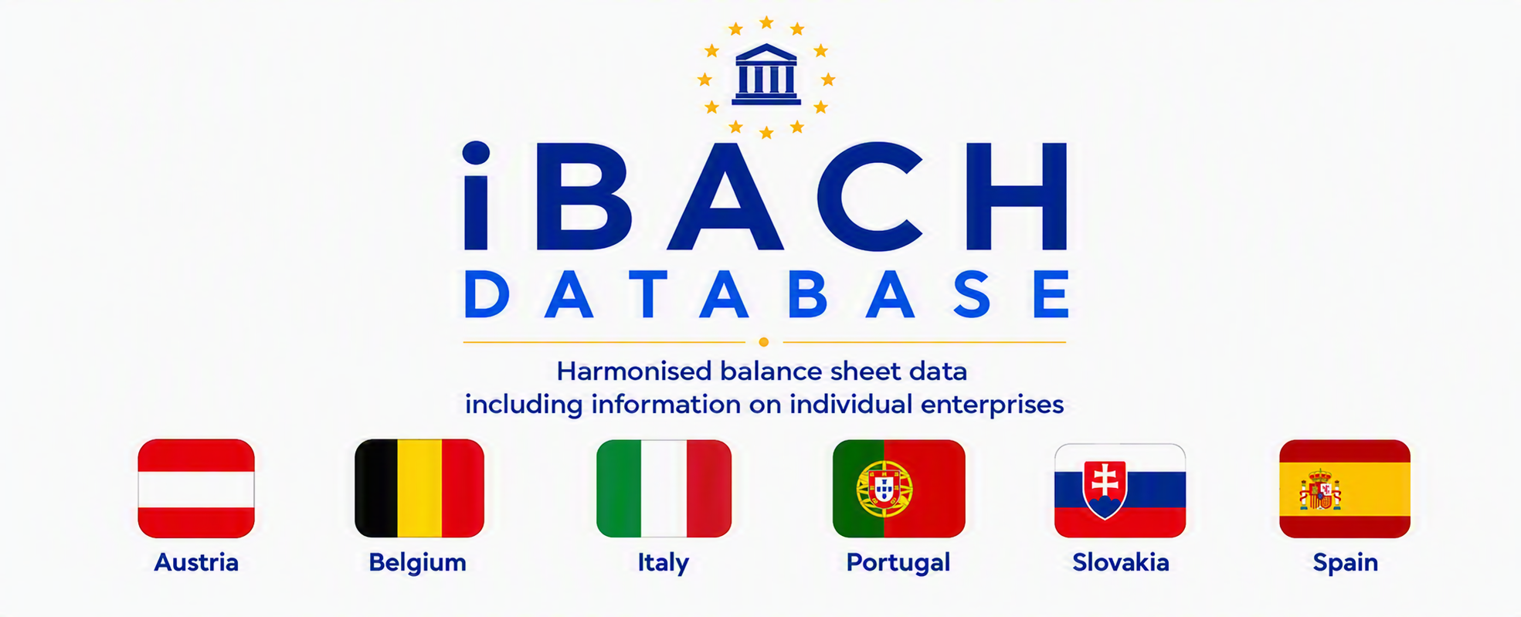
01 THE PILOT
02 ACCESS
What will be available?
Research without moving the microdata
For this conference, ECCBSO will offer exceptional, one-off access to a standardized dataset of anonymized, firm-level financial statements. The dataset reflects national contributions to the BACH framework from participating countries.
Selected researchers will access the data remotely through the BELab secure research infrastructure of Banco de España.
The underlying microdata remain within the controlled environment and are not provided as downloadable files.
03 RELEASE THE RESULTS
Output checking before release the results
CHARACTERISTICS OF THE AVAILABLE INFORMATION
1
2
3
1
Work inside the secure environment
Anonymized, firm-level financial statements, corresponding to the national contributions to the BACH dataset (iBACH)
Authorised
researcher
Secure remote
session
Analysis inside
BELab
2
Submit tables, figures or model results for review by the staff of the secure datalab
Historical series information on Non-Financial Corporations, according to the European System of Accounts (ESA2010)
CORE SAFEGUARDS
3
Extract only outputs that pass confidentiality checks
Countries giving access to their iBACH data: Austria, Belgium, Italy, Portugal, Slovakia, Spain
✓
Access restricted to authorised researchers
✓
Anonymised firm-level information
Possibility to merge with other national data sources relevant for the analyses within the secure environment
LIMITED CAPACITY
✓
Controlled data handling and remote access
Only a limited number of projects can be supported. ECCBSO will prioritise proposals according to their analytical relevance and quality.
✓
No direct extraction of confidential microdata
Specific access conditions and researcher obligations will be communicated by the hosting institution.

